Slide 1
Cannabis in New York State
An update on the work and priorities of OCM

Slide 2
How We Got Here…

Slide 3
What is Cannabis?
Cannabis Sativa is a versatile plant used for medicinal, industrial, and food purposes for thousands of years.
It contains hundreds of compounds, including cannabinoids, terpenes and flavonoids that, when they interact, have different effects on the mind and body. Most common and well known are THC, known for its euphoric feeling, and CBD, which offers the same potential benefits without the same “high.”
Hemp is the same plant as adult-use cannabis, it’s just one that contains 0.3% or less THC content and as a result is not a federally controlled substance.

Slide 4
What is the MRTA?
Economic Development
Public Health & Safety
Social Justice
MRTA was signed into law on March 31, 2021
Legalized adult-use cannabis (recreational marijuana) while also expanding the State’s existing medical cannabis and cannabinoid (CBD) hemp programs
Legalization represents a shift to a public health framework for cannabis policy
Notes:
One of the most important aspects of the MRTA is the emphasis it placed on economic development, social justice, and public health and safety.
Those concepts are woven throughout all aspects of the MRTA and you’ll see them reflected in the regulations and guidance documents produced by OCM.

Slide 5
Office of Cannabis Management (OCM)
OCM Oversees
Adult Use – Recreational
Medical Cannabis
Hemp

Slide 6
Cannabis Control Board
The New York State Cannabis Control Board is the approval and oversight body of the Office of Cannabis Management.
The Board is responsible for approving the comprehensive regulatory framework for New York's cannabis industry, including issuing applications and licenses to cannabis businesses and approving the rules and regulations which will govern the new industry.
Board meetings can be viewed on our website at Cannabis Control Board Meetings | Office of Cannabis Management (ny.gov).

Slide 7
Social & Economic Equity
Record Expungement
Community Reinvestment
Equity in the Market
Automatically
clears/removes cannabis convictions
Supporting people and communities most impacted by cannabis prohibition in building businesses
Put the money NYS makes from cannabis tax back into communities that were hurt by over policing

Slide 8
Making sure NYS does the right thing…
Social and Economic Equity built into the MRTA
Required 50% social equity licenses
Chief Equity Officer & OCM Equity Team
Economic Development
Small Business Development
Cannabis Advisory Board
13 members from across the state
Advise, guidance, and support

Slide 9
New York State Cannabis Tax Revenue Fund
All cannabis tax revenue deposited into this fund
Community Grants Reinvestment
Grants to non-profit and community-based organizations in communities disproportionately impacted by cannabis prohibition and other social equity initiatives as determined by the Cannabis Advisory Board
Drug Treatment & Public Education
Develop and implement statewide public education campaigns and provide substance use disorder treatment programs for youth and adults

Slide 10
An Update on the Office of Cannabis Management

Slide 11
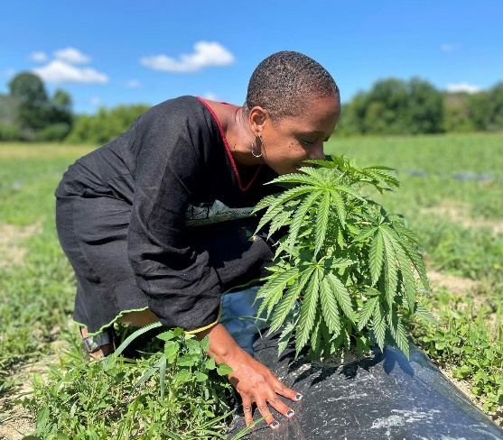
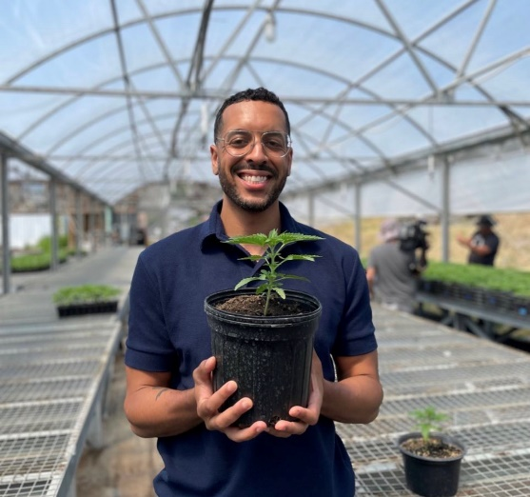
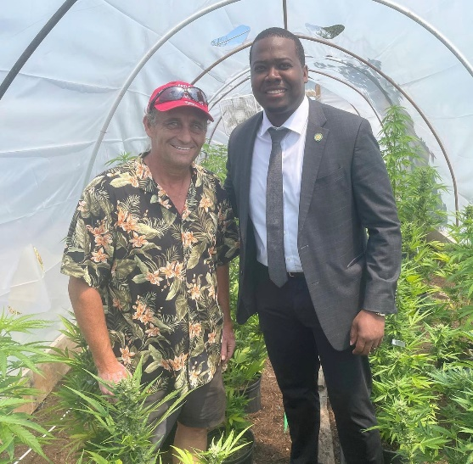
A Budding Agency
Cannabis Control Board
Chair Tremaine Wright
Regular meetings online & in person
Growing Since October 2021
Executive Director Chris Alexander
Regulatory, Public Health, Economic Development & Equity
We’re Still Hiring
https://cannabis.ny.gov/careers

Slide 12
Seeding Opportunity in NYS Cannabis – Where We Are Going

Slide 13
Seeding Opportunity Initiative
Conditional licenses to quickly stand-up NYS cannabis industry
Adult-Use Conditional Cultivators: launched March 2022
Adult-Use Conditional Processors: launched June 2022
Conditional Adult-Use Retail Dispensary (CAURD) was final conditional license released in August 2022
Open to some nonprofit organizations and justice involved individuals with qualifying business experience completing cannabis supply chain

Slide 14
Conditional Licenses To Date
277
Licensed Cultivators
33
Licensed Processors

Slide 15
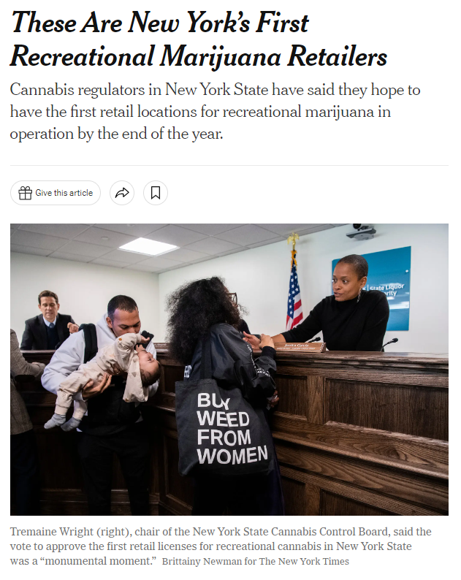
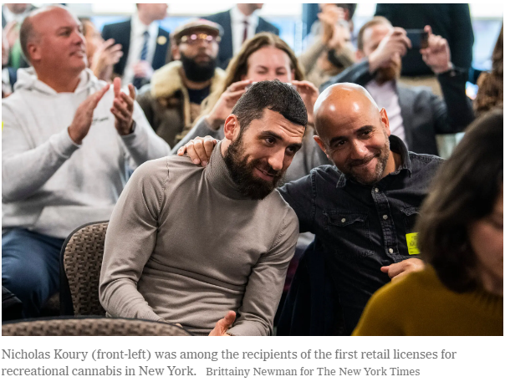
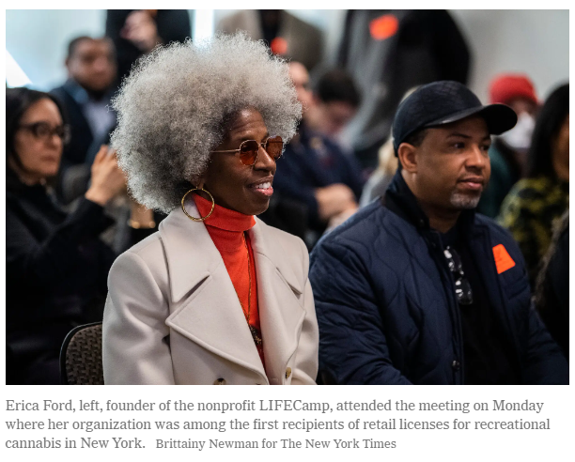
Conditional Adult-Use Retail Dispensary
CAURD applications closed on September 26, 2022
OCM received 903 applications
The first sales of legal cannabis in NYS will benefit either nonprofit organizations serving justice involved individuals or individuals who are justice involved themselves

Slide 16
CAURD Licenses To Date:
28
Qualifying Business
8
Non-Profit Orgs

Slide 17
CAURD: Non-Profit Licensees
New York City (5)
Housing Works Cannabis LLC
Housing Works
The Doe Store LLC
Doe Fund
Urban Weeds LLC
Urban Upbound
Kush & Kemet LLC
LIFE CAMPS
GOTHAM CAURD
Strive, Inc.
Rest of State (2)
CWS Holdings I, LLC
Challenge Industries
On Point Cannabis, INC
Broome County Urban League
Statewide (1)
NYCCABUDS – Center for Community Alternatives

Slide 18
CAURD: Business Licensees
Bronx (3)
Nube NYC LLC
Carl M. Anderson III
Royal Leaf NY
Queens (4)
Gabby’s Green LLC
CGG Enterprises Inc.
Suzanne M. Furboter
Anthony Crapanzano

Slide 19
CAURD: Business Licensees
Manhattan (4)
Smacked LLC
Gabriel Marin
Planet 51 LLC
Florisun LLC
Staten Island (2)
Eastern Holdings 88 LLC
SAMJNY Holdings LLC

Slide 20
CAURD Delivery Authorization Jumpstarting Adult-Use Market Sales
CAURD licensees are allowed to deliver cannabis products to customers under their retail dispensary authorizations.
Until matched with a DASNY location, the Office will allow CAURD licensees to fulfill delivery orders from a location obtained by the licensee that has been approved by the Office.
Licensees are still subject to applicable rules in retail guidance and CAURD True Party of Interest (TPI) guidance.
The Office will be providing additional guidance specific to CAURD delivery soon.
Delivery authorization will jumpstart AU retail sales in NYS.

Slide 21
Adult-Use Regulations

Slide 22
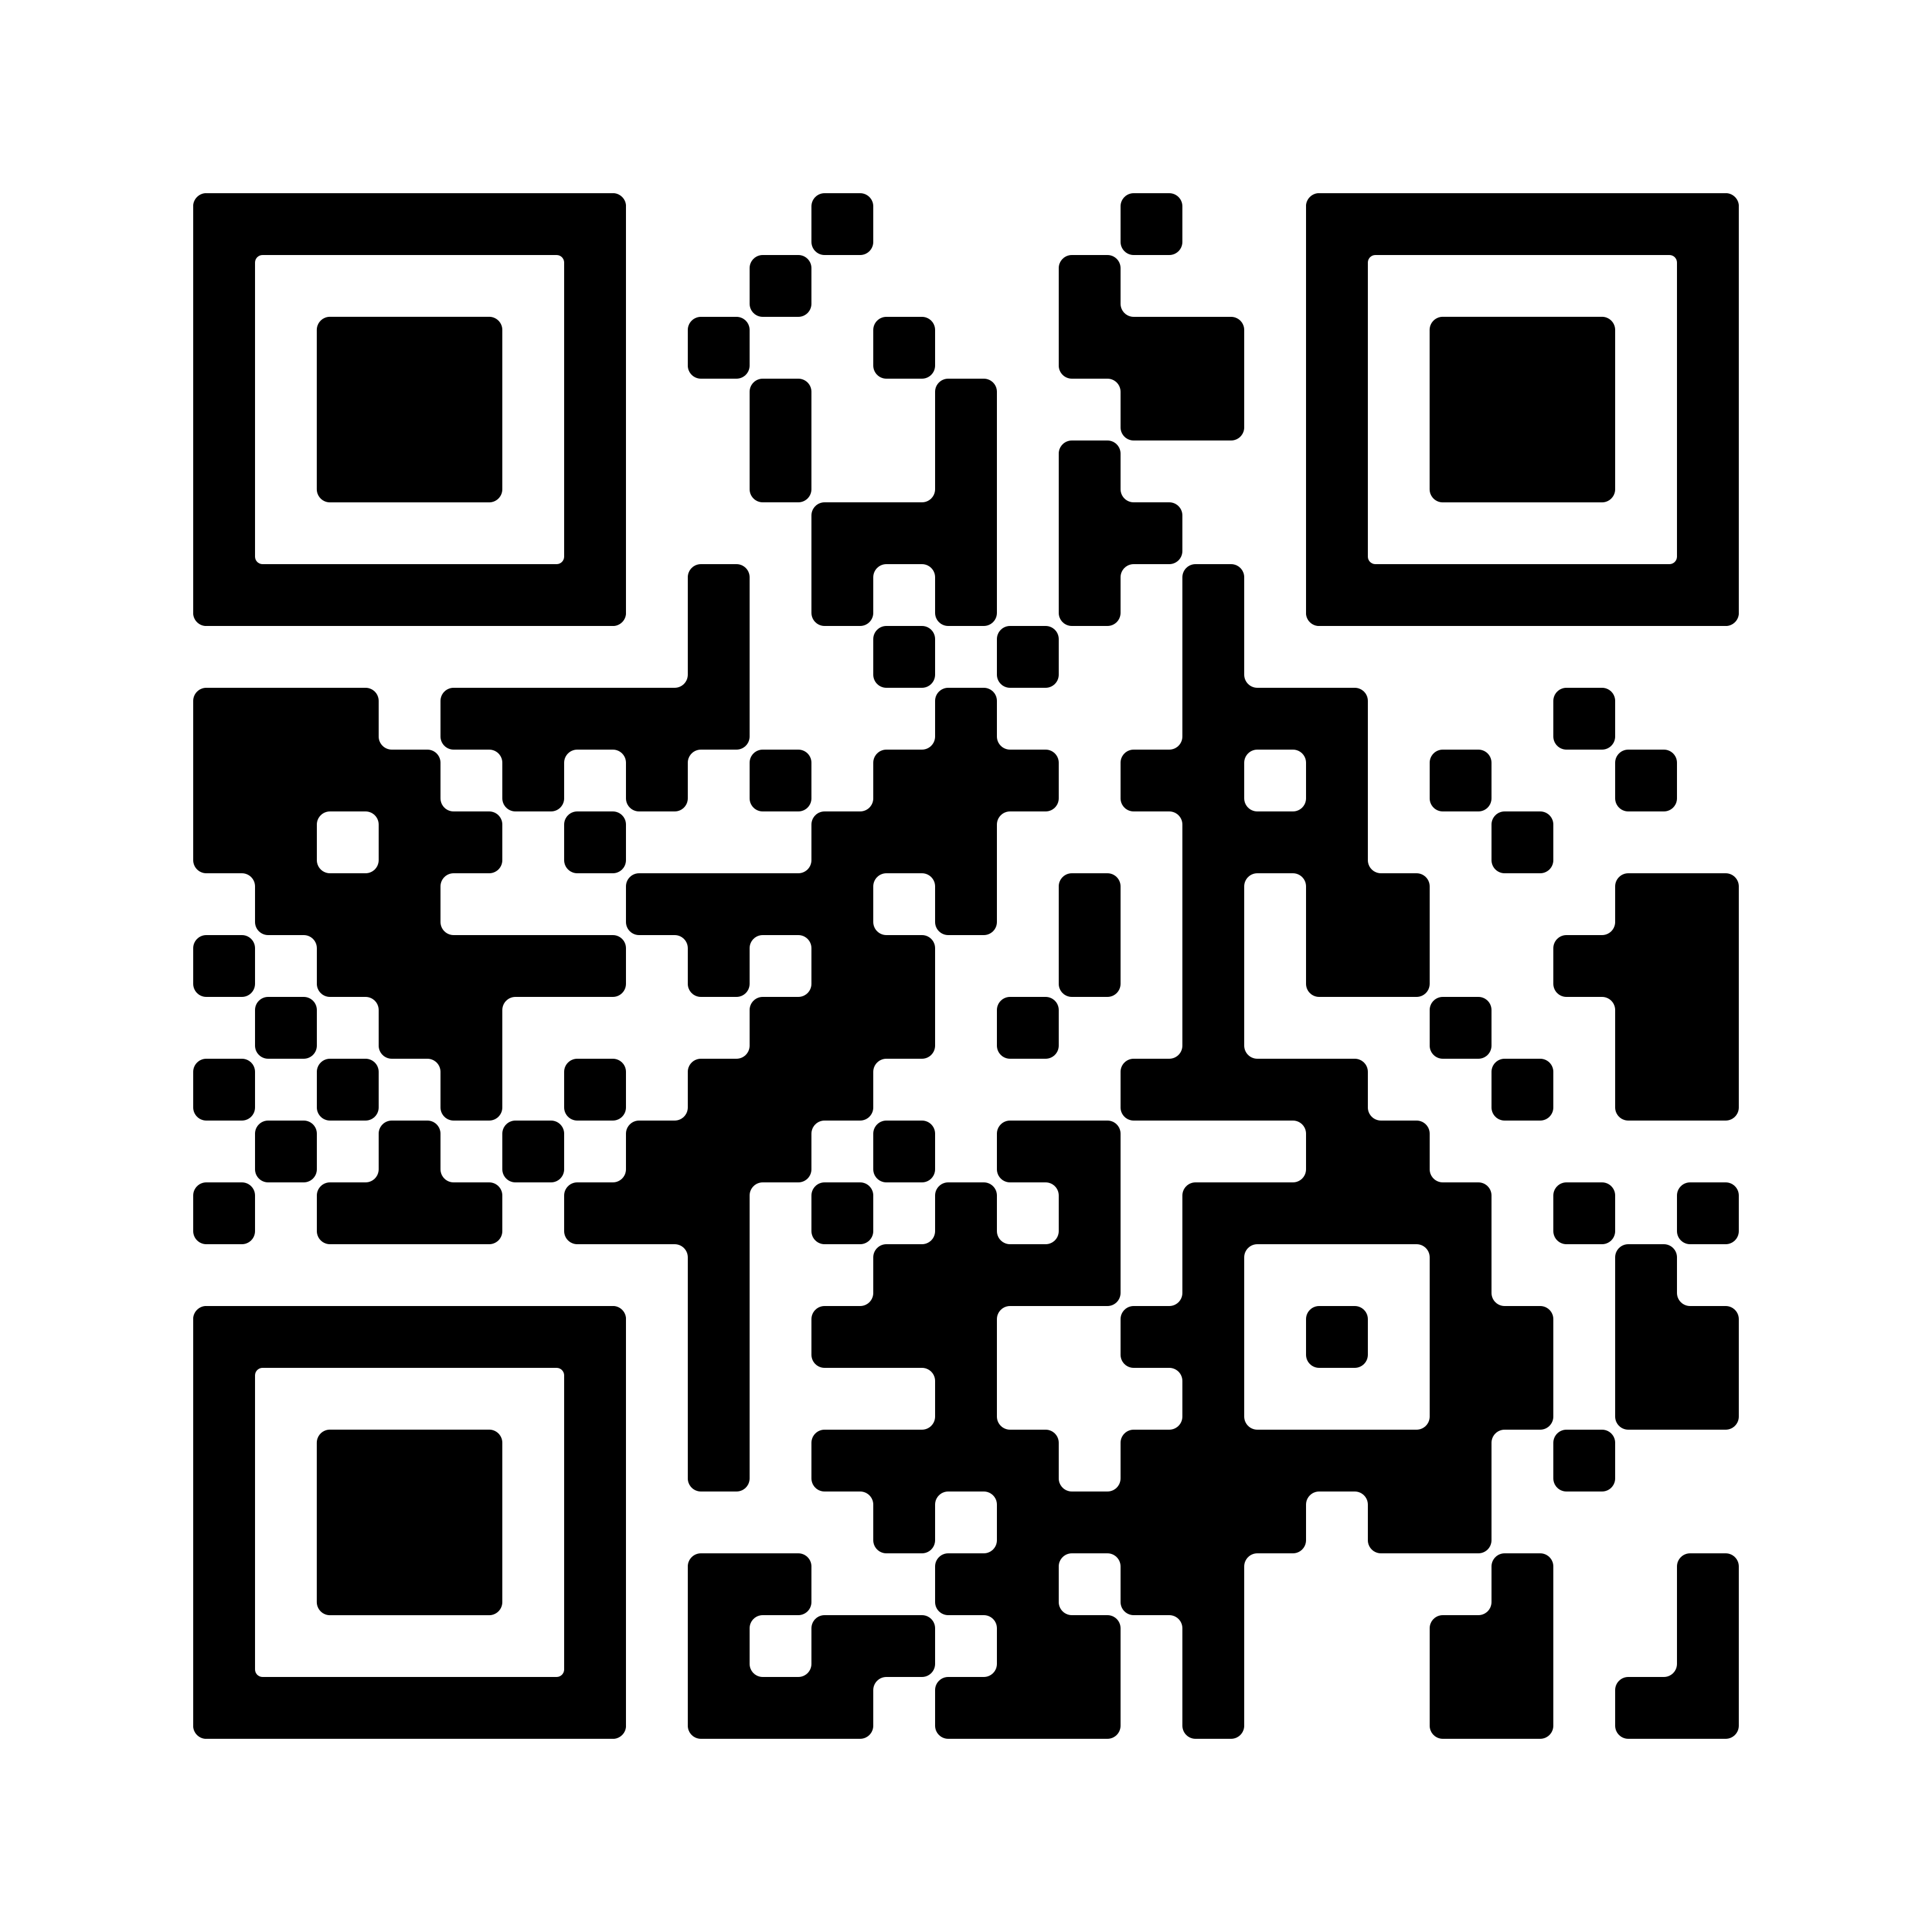
Proposed Adult-Use Cannabis Regulation Package Comprehensive Regulations to Build the Industry
This comprehensive package of adult-use regulations will, once finalized, create the application process for New York State’s cannabis businesses and set rules related to their ownership and operations.
The package consists of multiple Parts which, in concert, build an equitable and strong cannabis industry. The proposed regulations:
Create an application process to award a diverse range of nursery, cultivator, microbusiness, cooperative, processor, distributor, and retail dispensary licenses through an application process which allows for notification to municipal governments;
Maximize consumer choice and prioritize small businesses by creating the tiered market structure outlined in the Cannabis Law;
Open the door for a class of social equity licensees to build wealth and strengthen their communities; and
Ensure cannabis businesses protect public health and safety and operate in a way that minimizes their environmental impact.
Scan for a direct link to the proposed regulations:

Slide 23
Includes Application Process for:
Cultivator
Growing, cloning, harvesting, drying, curing, grading, trimming
Nursery
Only clones, immature plants, seeds, and other agricultural products
Processor
Extracts concentrated cannabis and/or compounds or manufactures
Distributor
Wholesale sale to dispensary, on-site consumption, or delivery service
Cooperative
Democratically controlled. Can cultivate, process, distribute. Cannot sell directly to consumer
Microbusiness
May be cultivator, processor, distributor or retailer. No person can own more than one license
Retail-Dispensary
Sells cannabis products directly to consumers

Slide 24
Proposed Adult-Use Cannabis Regulations Municipal Provisions
The proposed regulations outline how municipal governments can regulate the time, place and manner of cannabis licensees in accordance with the Cannabis Law. Municipalities can set rules related to cannabis business operations, hours of operation, zoning, and distance from certain special use areas, as long as those rules are not unreasonably impractical.
The proposed regulations:
Prohibit municipalities from imposing special fees on cannabis businesses;
Allow municipalities to choose to prevent retail dispensaries and on-site consumption licensees from operating late at night and from operating more than 70 hours per week; and
Outline a process for retail dispensary and on-site consumption applicants to notify a municipality of their intent to operate a cannabis license in the municipality's jurisdiction. A municipality can submit an opinion which will be considered by the Board on whether to grant or deny an application.
Mirror the SLA regulations for many distance and measurement provisions between special use areas.

Slide 25
Proposed Adult-Use Cannabis Regulations Social and Economic Equity
All applicants must demonstrate a commitment to social and economic equity.
Additionally, the proposed regulations invest in people most impacted by cannabis criminalization and, as is required by law, prioritize certain groups:
Individuals from a community disproportionately impacted by the enforcement of cannabis prohibition (CDIs)
Minority-owned businesses
Women owned businesses
Distressed farmers
Service-Disabled Veteran owned business
The proposed regulations create an equitable cannabis industry by:
Giving the most priority to individuals who have been convicted of a marihuana-related offense and are from a CDI; and
Waiving, deferring, or reducing the application and license fee for social and economic equity applicants

Slide 26
New York Prohibits Vertical Integration
Tiered System
Vertical Integration
Limits Choice & Competition
Promotes Competition
Supports Small Business
Tiered market structure outlined in MRTA
Created different categories of cannabis licenses
Designed to create a more competitive industry that supports smaller businesses

Slide 27
Proposed Adult-Use Cannabis Regulations Two-Tier Market
Like New York’s alcohol laws, the Cannabis Law creates a “two-tier” market. This prohibits vertical integration for most licensees. The Law does not allow someone to hold an interest in both a supplier (such as a cultivator) and a retailer (such as a dispensary).
The proposed regulations reduce barriers to entry, prioritize small businesses, and create competition. They do this by creating the two-tier market that the Cannabis Law requires. The proposed regulations:
Prevent a person from holding an interest in both a supplier and a retailer;
Stop suppliers from using gifts, discounts, loans, or other incentives to unduly influence retailers; and
Require applicants and licensees to identify all persons who profit based on the business’s success – even if they are not direct owners.

Slide 28
What does a tiered system look like?
Supply Tier
Cultivator
Nursery
Retail Tier
Dispensary
On-Site Consumption
Distributor
Processor
Medical
Laboratories
Delivery
Registered organizations
Sampling Firms
No person may have direct or indirect interest across tiers – this includes any stock ownership
Notes:
- A major focus of the MRTA is

Slide 29
Benefits of Tiered Market Structure
Home-Grown & Diverse Brands
similar to alcohol model
Increased Competition
reduced barriers to entry, avoids monopolistic practices
More Consumer Choice
limits ability to dominate shelf-space or control prices
Promotes Research
companies have to complete and innovate

Slide 30
Proposed Adult-Use Cannabis Regulations True Parties of Interest
True Parties of Interest: A framework designed to capture anyone with a Direct or Indirect interest in a cannabis license
This includes, but is not limited to an applicant or licensee’s:
Individuals with a controlling interest – Including: Sole proprietor, partner, member, manager, president, vice president, secretary, treasurer, officer, board member, trustee, director, or anyone with an equivalent title
Individuals with a share of ownership – Including: Stockholders (inclusive of persons with a future right to ownership), including passive investors, and any person who makes up the ownership structure of each level of ownership in the licensee
Individuals with a financial interest in the success of the business – Including: Goods and services providers or partners exceeding the 10%/50%/$100,000 thresholds
A spouse of any individual above

Slide 31
True Parties of Interest
How OCM identifies individuals/entities with a direct or indirect interest in a cannabis license
This includes, but is not limited to:
People with a controlling interest
People with a share of ownership
People with a financial interest in the success of the business
The spouse of any of the above
Notes:
OCM developed the “true party of interest” as a method to track compliance with restrictions related to the tiered cannabis system.
All licensees are required to disclose any individual or entity who meets the TPI definition
By collecting this information from all licensees, OCM will track and identify TPIs across all tiers to identify any individuals not in compliance.

Slide 32
Proposed Adult-Use Cannabis Regulations Public Health and Safety
The proposed regulations create protections to ensure the health and safety of licensees, their employees, and members of the public.
The proposed regulations ensure public health by:
Ensuring cannabis products are not in shapes that are attractive to individuals under twenty-one.
Ensuring products are made so that servings are clearly defined and in accordance with good manufacturing practice (GMP) standards.
Regulating the allowable ingredients and cannabis product forms permissible in the adult-use marketplace.
Establishing a framework for adverse event reporting for side effects and recall procedures as needed.

Slide 33
Proposed Adult-Use Cannabis Regulation Package Environment and Sustainability
The proposed regulations require licensees to monitor and limit their impact on the environment. Licensees will be encouraged to reduce waste and implement practices that re-use and recycle. The proposed licensing structure would encourage mixed-light and outdoor cultivation by making those license types more accessible.
Additionally, the proposed regulations require licensees to document, implement, and maintain an Energy and Environmental Plan which includes, but is not limited to, information related to the licensees’:
Energy use & impact, including the energy efficiency of structures within the licensee’s site and practices to reduce energy use;
Lighting, if the licensee cultivates using lights;
Packaging materials, if the licensee packages;
Plan to reduce the licensee’s greenhouse gas emissions and reliance on fossil fuels, in accordance with New York’s Climate Leadership and Community Protection Act;
Ecological regeneration practices; and
Water conservation.

Slide 34
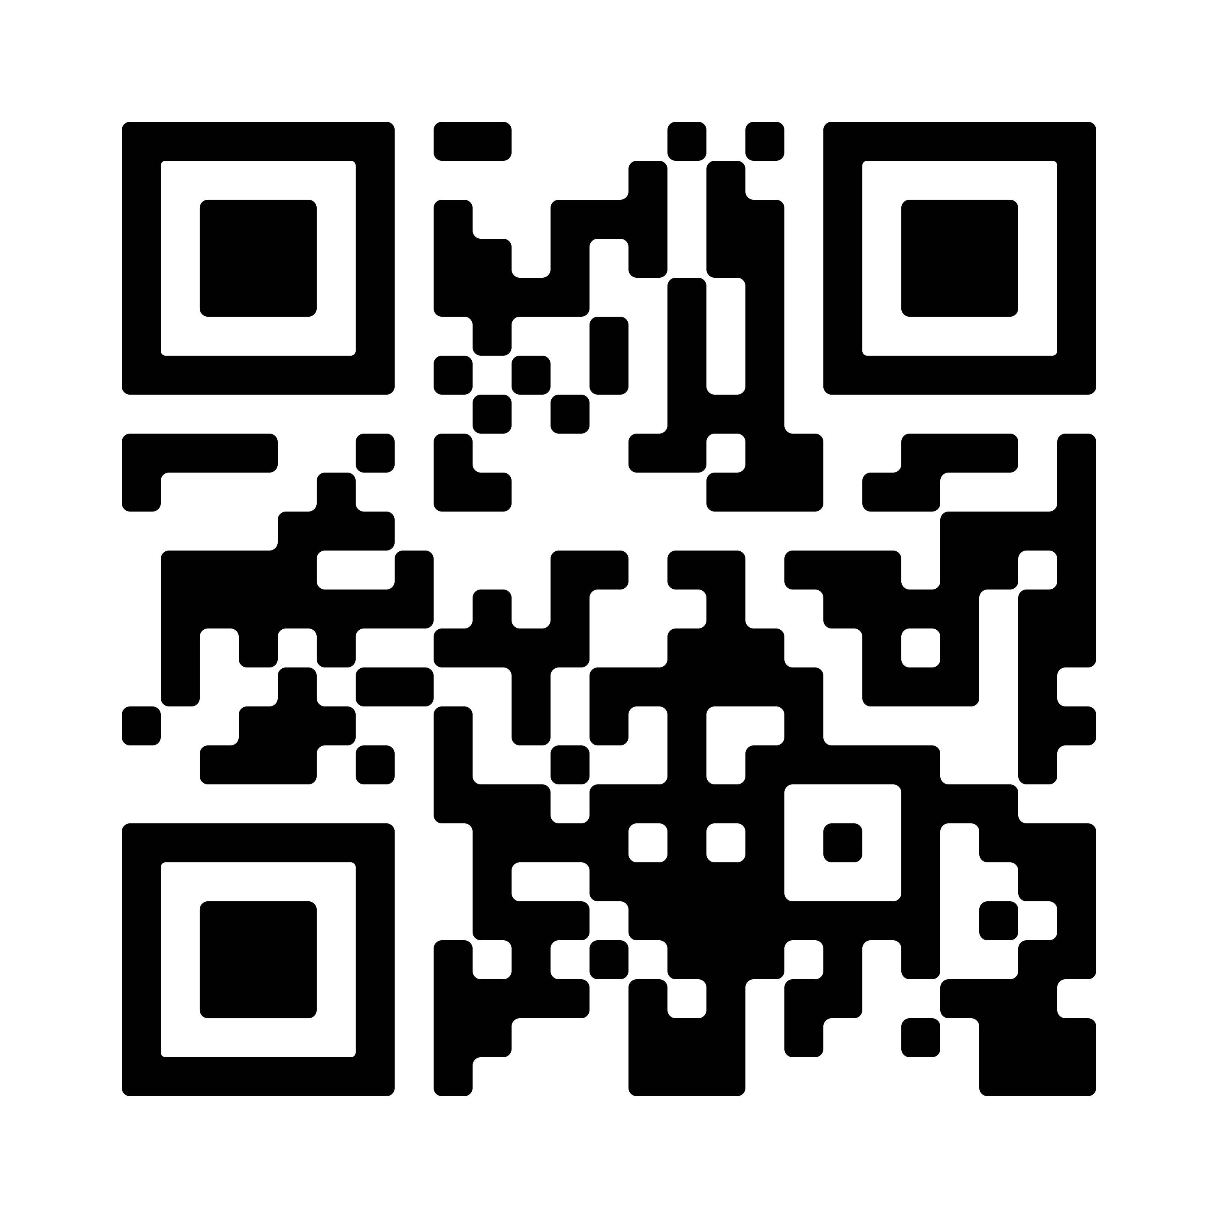
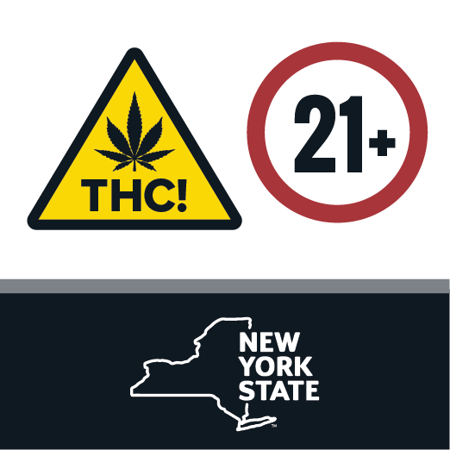
Proposed Packaging and Labeling & Marketing and Advertising (PLMA) Regulations
Scan for a direct link to the proposed regulations:
This month, the CCB revised the proposed Packaging and Labeling & Marketing and Advertising (PLMA) regulations as a result of public comment. These revised regulations are not finalized.
Revisions will:
Create more flexibility for licensees to build their brands while maintaining robust public health standards;
Allow additional use of images, branding, and graphics in cannabis product packaging and labeling, including through special branding material; and
Strengthen sustainability efforts by allowing licensees to conduct redemption programs as part of an approved sustainability plan.
Revised regulations have been filed for additional 45-day comment period. Comments can be filed by email at regulations@ocm.ny.gov

Slide 35
Comment on Regulations
The proposed regulations will be filed for a 60-day public comment period beginning December 14th, 2022.
Comments can be filed by email at regulations@ocm.ny.gov or sent via mail to:​
New York State Office of Cannabis Management​
PO Box 2071 Albany, NY 12220​

Slide 36
What is legal in NYS?

Slide 37
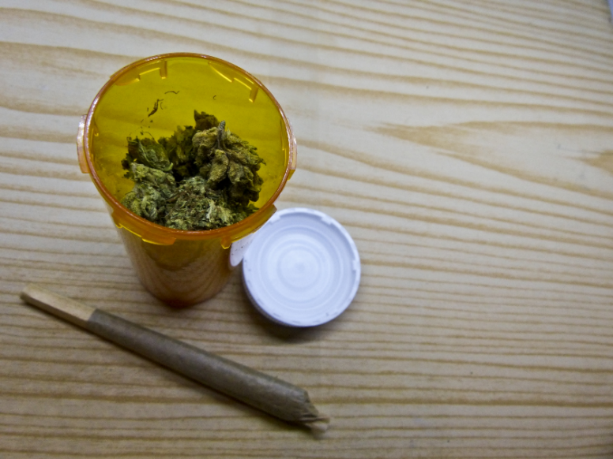
What is Legal in NYS – Possessing Cannabis
Adults over 21 can buy and posses:
Up to three ounces of cannabis flower
Up to 24 grams of concentrated cannabis (oils, tincture, edibles, vapes, etc.
Cannabis can be consumed in a private home or state-licensed on-site consumption site
Currently there are no licensed on-site consumption sites
Vaping and smoking cannabis is not allowed anywhere vaping and smoking tobacco isn’t allowed
This Photo by Unknown Author is licensed under CC BY

Slide 38
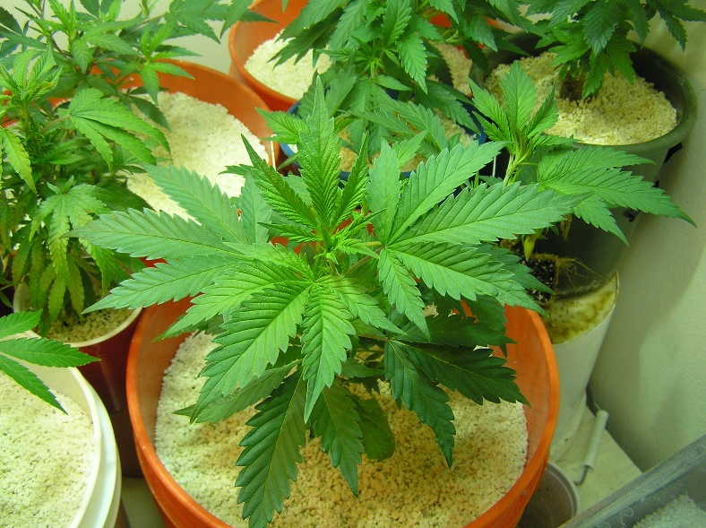
What is Legal in NYS – Growing Cannabis
As of 10/30/22 home cultivation is only legal for NYS certified medical patients and their designated caregivers
Eventually, New Yorkers who are 21 and older can grow in their own home:
Up to six plants for personal use (3 mature plants and 3 immature plants)
A maximum of 12 plants per household (even if there are three or more adults over the age of 21)
This Photo by Unknown Author is licensed under CC BY-SA-NC

Slide 39
Who is Eligible for Medical Home Grow
Certified Medical Cannabis Patients
Designated Caregivers
Must be registered in NYS Medical Cannabis Program

Slide 40
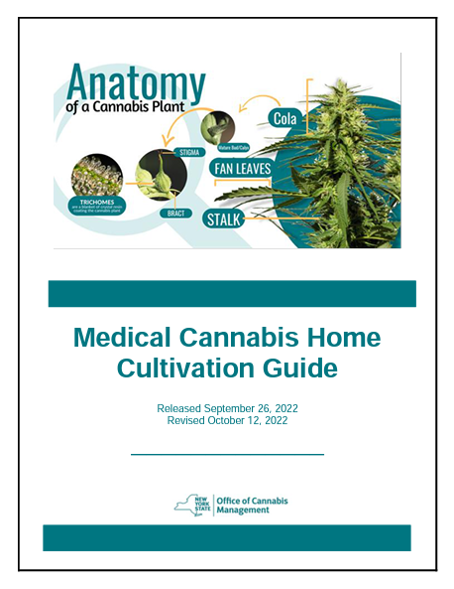
Rules for Medical Cannabis Home Grow
A patient must be at least 21 years old to grow cannabis for themselves
Patients under 21 must use a designated caregiver
Certified patients may have one caregiver grow on their behalf
Designated Caregivers may cultivate for up to 4 certified patients

Slide 41
Rules for Medical Cannabis Home Grow
Patients/caregivers cannot sell any seeds or cannabis grown at home
They can give away (transfer) cannabis to another patient or caregiver – up to 3 ounces of flower or 24 grams of concentrated cannabis
Designated Caregivers may not charge for growing cannabis but may be reimbursed for related expenses

Slide 42
Growing in a Private Residence
Patients (or caregivers) may only grow in or on the grounds of their private residence
This can be a home you own or rent
If you rent, check your lease before you grow
You cannot grow in an assisted living facility, rehab center or similar location
You cannot grow cannabis in any federally funded or recognized public housing site

Slide 43
Limits on Home Grow
One Certified Patient
3 Immature Plants
3 Mature Plants
Two Certified Patients
6 Immature Plants
6 Mature Plants
Three or More Certified Patients
6 Immature Plants
6 Mature Plants
No household can ever have more than 12 plants (6 mature, 6 immature) even if multiple certified patients live there or a caregiver is growing for multiple patients

Slide 44
What is Legal in NYS – Adult-Use Cannabis Sales
CAURD licensees will be making the first legal adult-use sales with cannabis products grown by New York Farmers.

Slide 45
OCM Enforcement Activities

Slide 46
OCM Enforcement Actions
The MRTA allows for OCM to engage in enforcement actions against licensed hemp/cannabis operators.
For the many unlicensed cannabis businesses, OCM and localities are finding ways to work collaboratively for the Office to report cases of illicit sales so the localities can initiate and promptly proceed with enforcement actions including seizure of illicit cannabis, fines, and closure of stores.
UNLICENSED

Slide 47
OCM Enforcement Actions
OCM’s Enforcement Division has been collecting details (locations, owners, products sold etc.) on all illicit cannabis operations since January of 2022.
The information collected from law enforcement, elected officials, and concerned citizens has been saved by the Enforcement Division and used to conduct investigations into these operations.
Beginning in early 2022, the Enforcement Division began conversations across the State with local DA’s and law enforcement about the role of the local DA and law enforcement in cannabis enforcement as it pertains to Article 222 of the Penal Law.

Slide 48
OCM Enforcement Actions
NYS Penal Law ARTICLE 222 CANNABIS: General
222.00 Cannabis; Definitions: Defines “Cannabis,” “Concentrated Cannabis,” “Sell,” and “Smoking.”
222.05 Personal Use of Cannabis: It is now legal to: possess, display, purchase, obtain, transport, transfer WITHOUT COMPENSATION (AKA “gifting”) up to 3 oz. of flower and/or 24 g of concentrate; to possess, use, display, purchase, obtain, manufacture, transport, or give to a person 21 years of age or older, cannabis paraphernalia (pipes, bongs, vaporizers, rolling papers etc.); to plant, cultivate, harvest, dry, process and possesses cultivated cannabis in accordance with the Cannabis Law.
There can be no finding or determination of reasonable cause to believe a crime has been committed based solely on evidence of the following facts and circumstances, either individually or in combination with each other: odor of flower; odor of burnt cannabis; possession within legal limits; possession within legal limits of multiple containers of cannabis; the presence of cash in proximity to cannabis; the planting, cultivation, harvesting, or processing of cannabis.
222.10 Restrictions on Cannabis Use: No person shall: smoke/vape cannabis where smoking/vaping is prohibited by the Public Health Law/Clean Indoor Air Act; or upon the grounds of a school, or in or on a school bus.
222.15 Personal Cultivation and Home Possession of Cannabis: A County, Town, City, or Village may enact and enforce regulations to reasonably regulate the actions and conduct personal cultivation; provided that: cultivation cannot be completely or essentially prohibited; local regulation may constitute no more than an infraction and may be punishable by no more than a discretionary civil penalty of $200 or less; a violation of this section (222.15), may be subject to a civil penalty of up to $125 per violation; OCM is mandated to issue, enact and enforce guidance, regulations and conduct education to promote safe practices in home cultivation and use/storage of cannabis.
222.20 Licensing of Cannabis Production and Distribution; Defense: In any prosecution for an offense involving cannabis, it is an affirmative defense that the defendant was engaged activity in compliance with the Cannabis Law.

Slide 49
OCM Enforcement Actions
NYS Penal Law ARTICLE 222 CANNABIS: Possession
222.25 Unlawful Possession of Cannabis: Knowingly and unlawfully possesses cannabis weighing more than 3 oz. or concentrate weighing more than 24 g. Violation punishable by a fine of not more than $125.
222.30 Criminal Possession of Cannabis, 3rd Degree: Knowingly and unlawfully possesses: 1. Cannabis weighing more than 16 oz.; or 2. Concentrated cannabis and such concentrate cannabis weighing more than 5 oz. Class A Misdemeanor (15-days to one year.)
222.35 Criminal Possession of Cannabis, 2nd Degree: Knowingly and unlawfully possesses: 1. Cannabis weighing more than 5 lbs.; or 2. Concentrate weighing more than 2 lbs. Class E Felony (No more than 4 years.)
222.40 Criminal Possession of Cannabis, 1st Degree: 1. Knowingly and unlawfully possesses cannabis weighing more than 10 lbs.; or 2. Concentrate weighing more than 4 lbs. Class D Felony (No more than 7 years.)

Slide 50
OCM Enforcement Actions
NYS Penal Law ARTICLE 222 CANNABIS: Sale
222.45 Unlawful Sale of Cannabis: Knowingly and unlawfully sells cannabis/concentrate. Violation punishable by a fine of not more than $250.
222.50 Criminal Sale of Cannabis, 3rd Degree: 1. Knowingly and unlawfully sells more than 3 oz. of cannabis or more than 24 g. of concentrate; or 2. Being 21 years of age or older, knowingly and unlawfully sells/gives, or causes to be given/sold, cannabis/concentrate to a person less than 21 years of age;
Shall not apply to designated caregivers, practitioners, employees of a registered organization, or employees of a designated caregiver facility. Class A Misdemeanor (15-days to one year.)
222.55 Criminal Sale of Cannabis, 2nd Degree: 1. Knowingly and unlawfully sells more than 16 oz. of cannabis or more than 5 oz of concentrate; or 2. Being 21 years of age or older, knowingly and unlawfully sells/gives, or causes to be given/sold, more than 3 oz. of cannabis or more than 24 g. of concentrate to a person less than 18 years of age. Shall not apply to designated caregivers, practitioners, employees of a registered organization or employees of a designated caregiver facility. Class E felony (No more than 4 years.)
222.60 Criminal Sale of Cannabis, 1st Degree: Knowingly and unlawfully sells more than 5 lbs. of cannabis or more than 2 lbs. of concentrated cannabis. Class D felony (No more than 7 years.)
222.65 Aggravated Criminal Sale of Cannabis: Knowingly and unlawfully sells cannabis/concentrate cannabis weighing 100 pounds or more. Class C felony (No more than 15 years.)

Slide 51
OCM Enforcement Actions
In February of 2022, the OCM delivered the first set of Cease & Desist letters to those suspected of conducting unlicensed cannabis sales.
In July of 2022, the OCM delivered a second, follow-up set of Cease & Desist letters to the operators from the first set of letters delivered in February.
The Enforcement Division continues to staff up and engage in enforcement actions across the state; visiting illicit stores, issuing cease and desist letters on the spot to stores conducting themselves contrary to existing law, and assisting local law enforcement in other enforcement mechanisms (code violations, local laws.)

Slide 52
Commercial Store Fronts
Illicit Sales
Since no adult-use retail dispensaries operations outside of the medical program are legal yet, OCM is working with local governments and their agencies to sanction and close these locations permanently.

Slide 53
Mobile / Food Trucks
Illicit Sales
No “food truck’ or other commercial vehicle sales of adult-use cannabis are legal in NYS.
OCM’s Enforcement team has been working with local governments to sanction these mobile food trucks for violations which will allow them to be removed from the streets: parking tickets/DOH food service violations/expired out-of-state vehicle registrations, improper registrations etc. are being used to shut down operations.

Slide 54
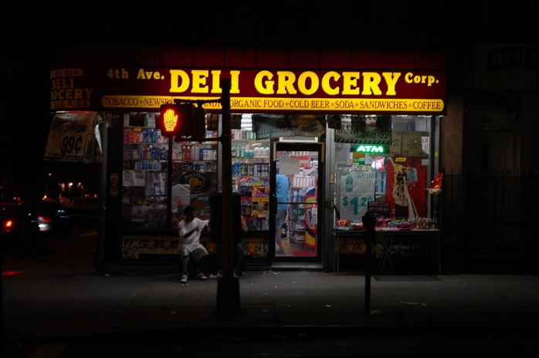
Small Grocery Stores / Bodegas / Gas Stations
Illicit Sales
When the MRTA was signed into law, there was never an intention for small grocery stores/bodegas/corner stores/gas stations to begin engaging in sales of adult-use cannabis within their existing business. Only licensed and registered dispensaries should be doing so.
OCM’s Enforcement team has been working closely with local governments and their agencies to find innovate ways to stop these establishments for engaging in illicit cannabis sales, including educating those who may not be aware that what they are doing is illegal.
This Photo by Unknown Author is licensed under CC BY-SA-NC

Slide 55
Where to report illicit sales
For establishments engaging in illicit sales right now, please report such activity to: enforcement@ocm.ny.gov

Slide 56
Share Feedback on Regulations
regulations@ocm.ny.gov
via mail to:
New York State Office of Cannabis Management
PO Box 2071
Albany, NY 12220

Slide 57
Stay Connected to OCM
Sign up for OCM Email Updates at: cannabis.ny.gov
OCM Help Line:
1-888-OCM-5151
Follow OCM on Social Media @nys_cannabis
Twitter
Instagram
Facebook

Slide 58
Thank You

